Slide 1
Text mining and Readability
OLEKSANDR KRAKOVETSKYI
CEO, DevRain Solutions
Microsoft RD/MVP, PhD., @msugvnua
http://wp7rocks.com

Slide 2
Theory

Slide 3
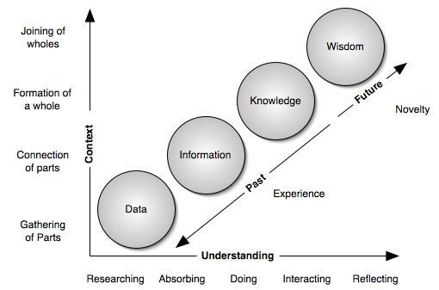
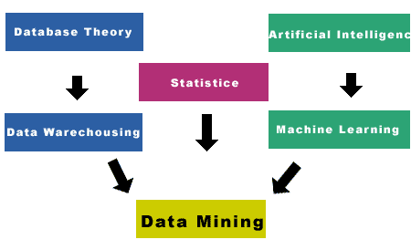
Information levels

Slide 4
What’s Text Mining?
Text mining refers to the process of deriving high-quality information from text. 'High quality' in text mining usually refers to some combination of relevance, novelty, and interestingness. Typical text mining tasks include text categorization, text clustering, concept/entity extraction, production of granular taxonomies, sentiment analysis, document summarization, and entity relation modeling (i.e., learning relations between named entities).

Slide 5
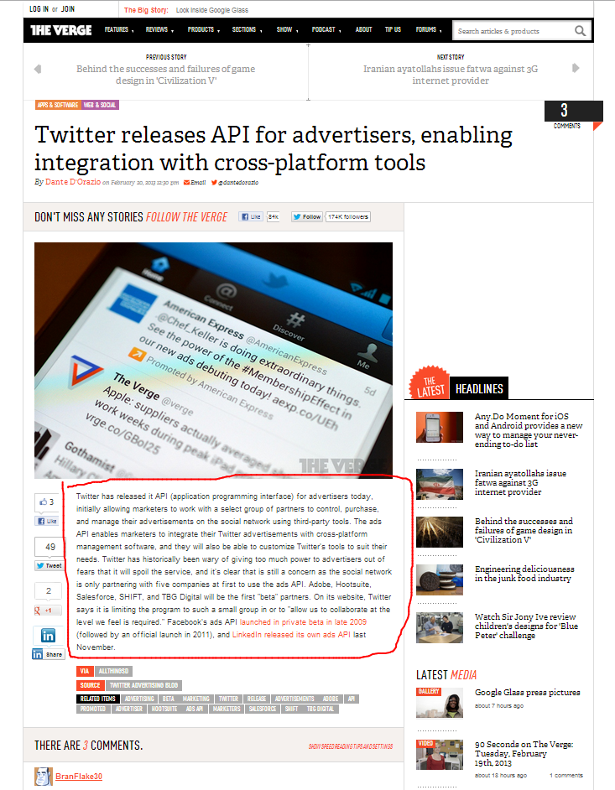
Goals
Initial goal (was in 2009):
Write an algorithm for determining main content of web pages
More precise goal:
Determine properties for content importance evaluation
* Later will be know as Readability

Slide 6
Importance levels
Level 1: noisy information such as advertisement, copyright, decoration, etc.
Level 2: useful information, but not very relevant to the topic of the page, such as navigation, directory, etc.
Level 3: relevant information to the theme of the page, but not with prominent importance, such as related topics, topic index, etc.
Level 4: the most prominent part of the page, such as headlines, main content, etc.

Slide 7
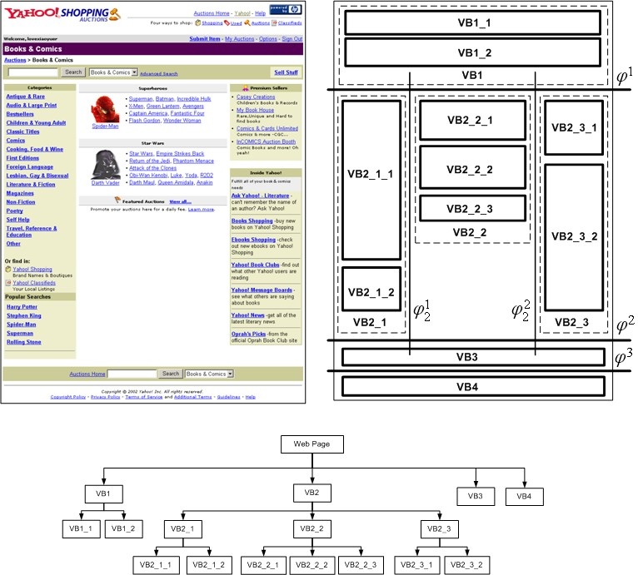
Goals
Additional goal:
Web page segmentation algorithm
* VIPS from Microsoft Research

Slide 8
Tools & Approaches
Structure analysis:
pattern recognition;
DOM analysis (semantic tags);
Statistics / SeoRank;
NLP;
others.

Slide 9
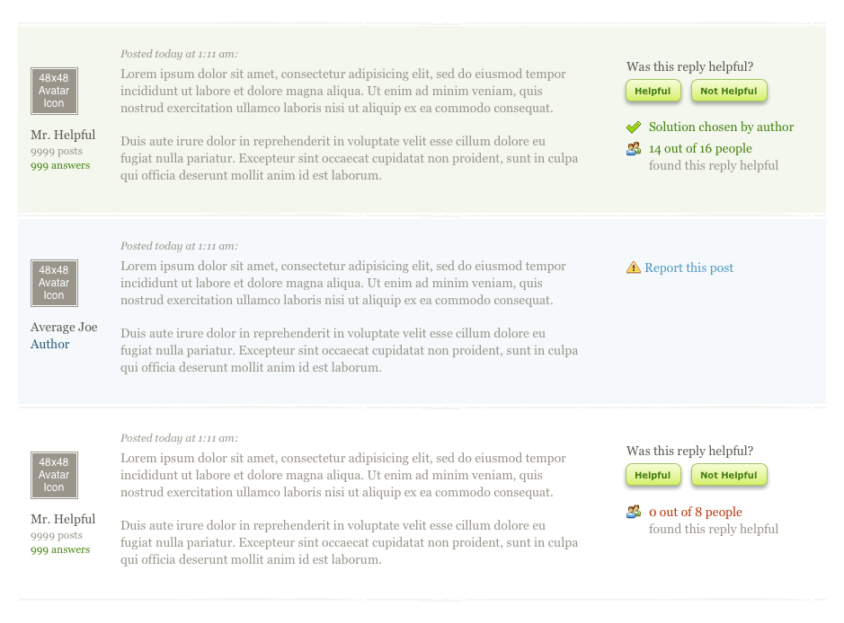
Pattern recognition
Good for data with the similar structure:
Wikipedia;
Forums;
Wordpress;
Etc.

Slide 10
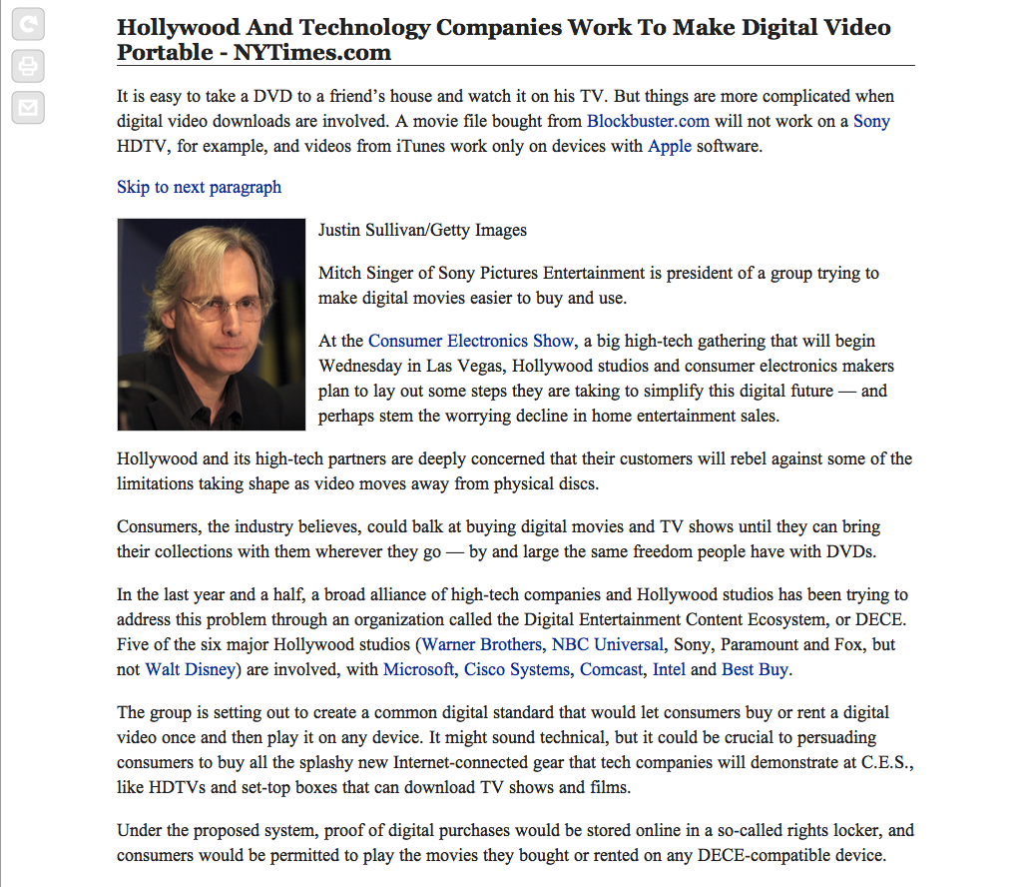
Block length
Looking for blocks with maximum length
* after cleaning information “noise”, well-known data patterns

Slide 11
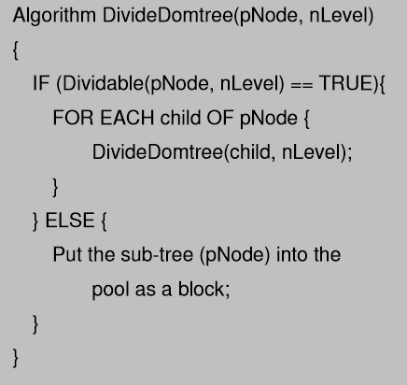
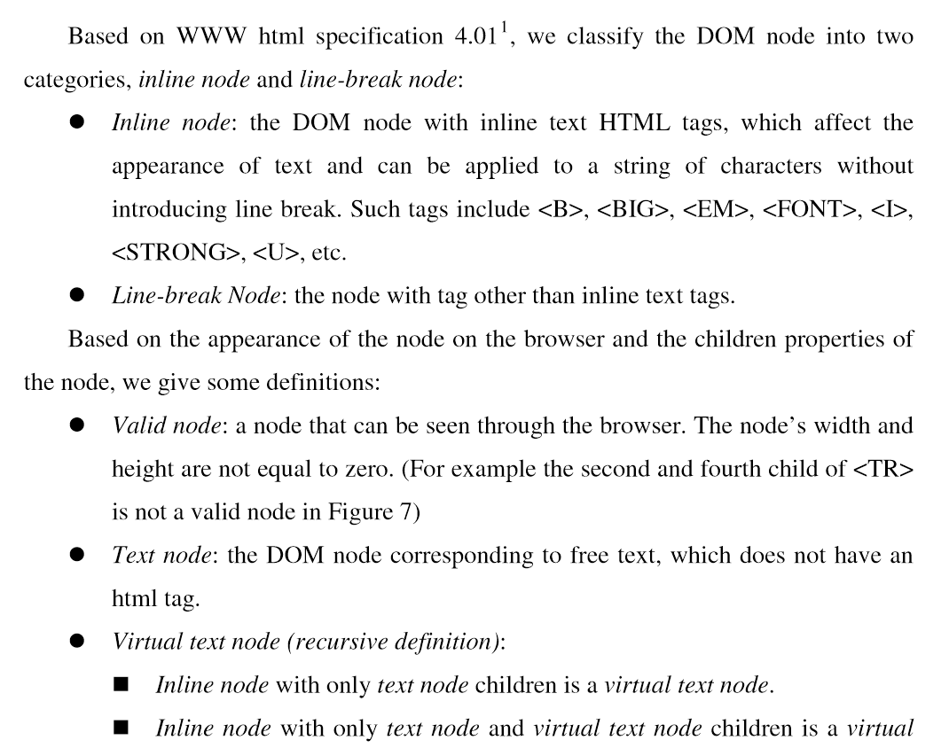
VIPS algorithm

Slide 12

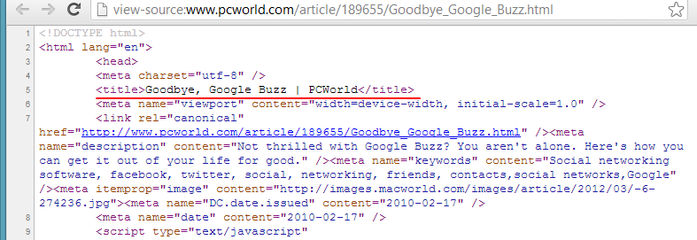
SeoRank
Page meta information should be similar to main content:
title;
meta description;
meta keywords.

Slide 13
SeoRank Statistics
Avg. value of SeoRank for main content: 0.91;
Avg. value of SeoRank for entire webpage: 0.84;
Avg. value of SeoRank SeoRank for all non-main blocks: 0.42;
Pages where SeoRank for main block has a maximum value: 94%.
* used PCWorld, habrahabr.ru, BBC and other resources

Slide 14
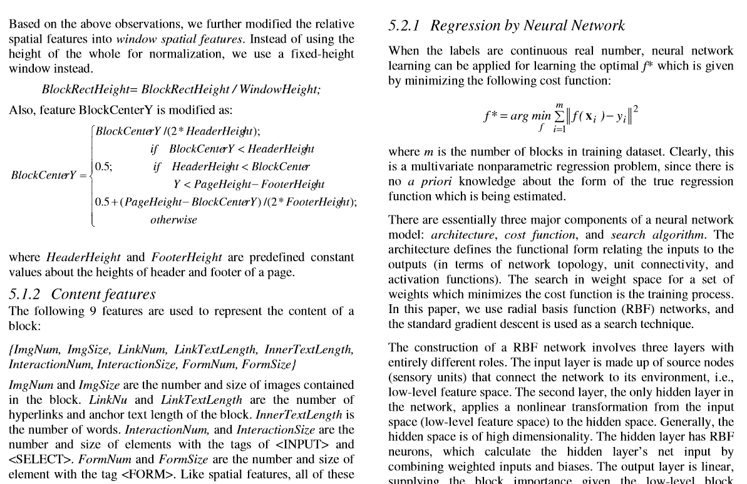
VIPS and Blocks Importance

Slide 15
Practice

Slide 16
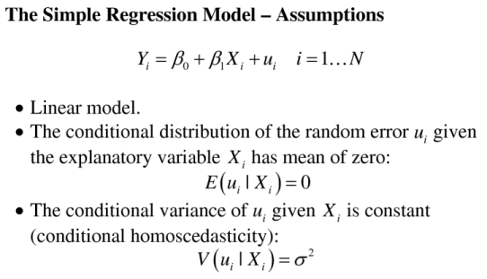
Algorithm Flow
Crawl as many webpages as can;
Slice webpages to information blocks;
Manually create ‘ideal’ dataset with evaluated blocks;
Calculate properties (~ 20) for all blocks;
Create regression model (remove not necessary properties);
Result: working (!) regression model

Slide 17
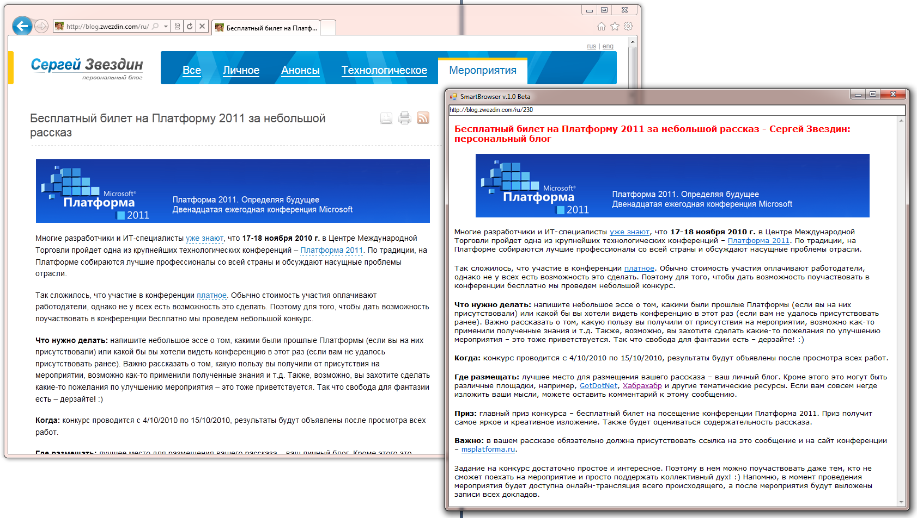
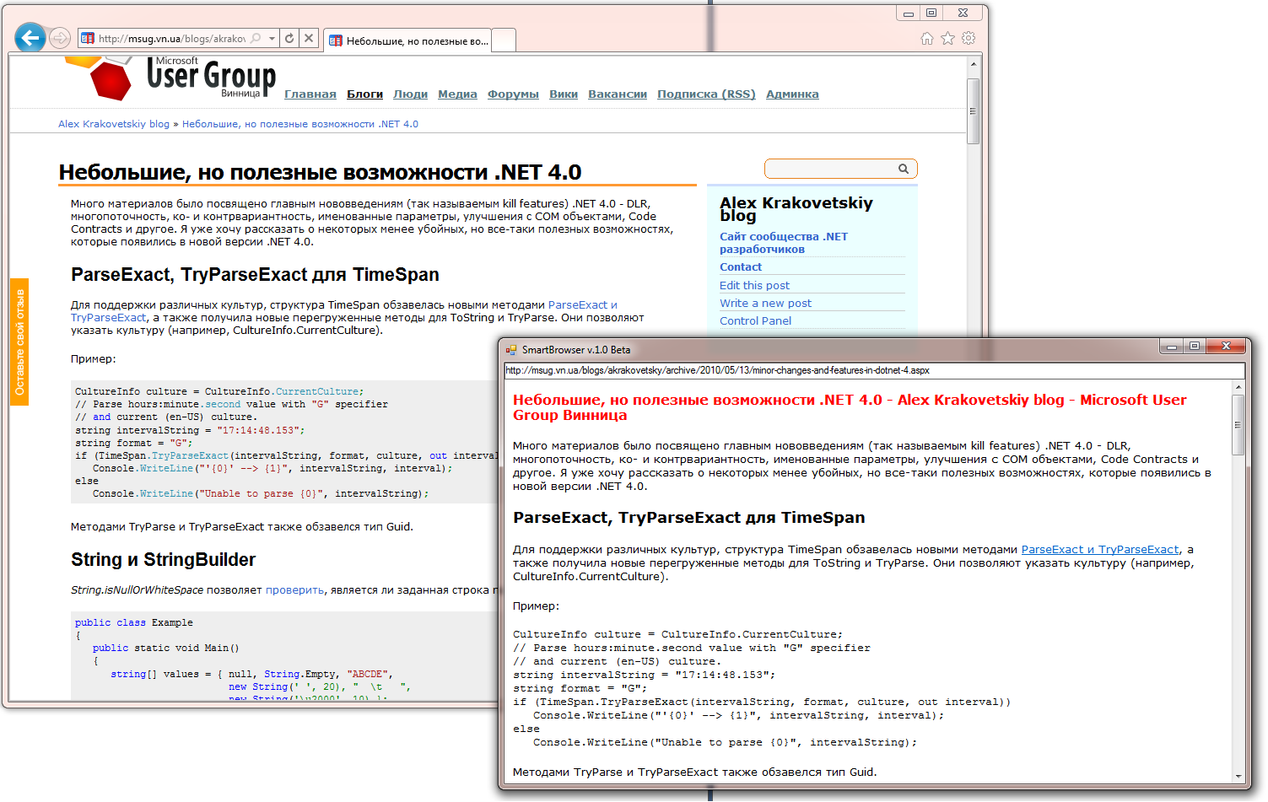
SmartBrowser

Slide 18
Algorithm issues
Test dataset should be huge and more precise!
One approach won’t work for all web.
Sometimes simple algorithms rocks!
Not working for some kind of websites: social networks, AJAX websites, main pages, pages with JavaScript security tricks.

Slide 19
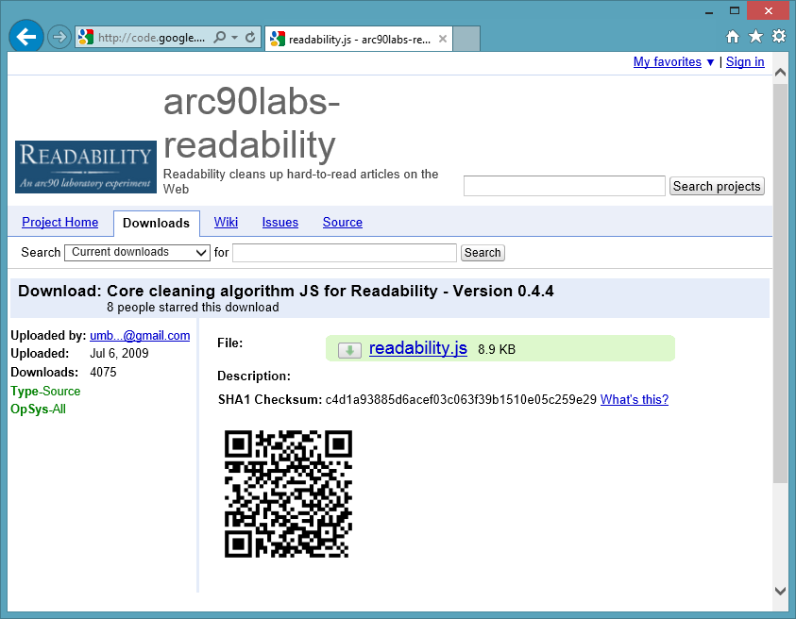
Readability
Safari 5
Amazon Kindle
Flipboard
Etc.
via Arc90 Lab

Slide 20
Q&A
Data Mining SDK
http://datamining.codeplex.com
SmartBrowser
http://smartbrowser.codeplex.com
@msugvnua
Alex.Krakovetskiy@devrain.com

